Slide 1


Atomic Structure Review
Notes:
Insert cover image and use transparency settings to fade image.

Slide 2


Atomic Structure Review
I can / will be able to:
Draw a labelled diagram of an atom
Describe the properties of subatomic particles (P, N, E)
Recall how to read an element from the Periodic Table
Explain the difference between an isotope and an element
Draw electron configurations of the first 20 elements

Slide 3
READ WITH ME
Draw a labelled diagram of an atom of lithium

Slide 4
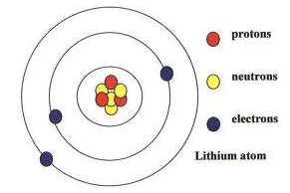
READ WITH ME
Draw a labelled diagram of an atom of lithium

Slide 5
Subatomic particles
Particle | Symbol | Location | Relative charge | Relative mass
proton
neutron
electron

Slide 6
Subatomic particles
Particle | Symbol | Location | Relative charge | Relative mass
proton
neutron
electron

Slide 7
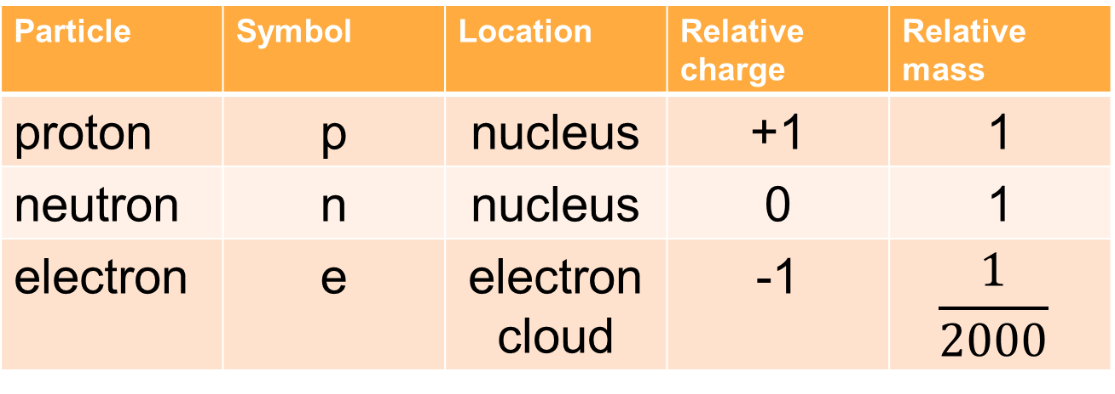
Subatomic particles
Particle | Symbol | Location | Relative charge | Relative mass
proton | p | nucleus | +1 | 1
neutron | n | nucleus | 0 | 1
electron | e | electron cloud | -1 | $$\frac{1}{2000}$$

Slide 8
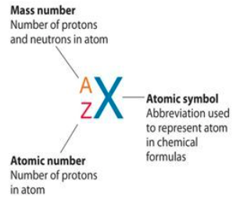
Representing elements
An element can be represented using a symbol

Slide 9
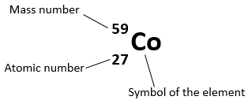
Example
Element name =
Number of protons =
Number of neutrons =
Number of electrons =

Slide 10
Answers
Element name = cobalt
Number of protons = 27
Number of neutrons = 32
Number of electrons = 27

Slide 11
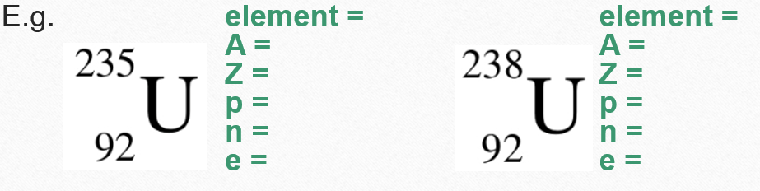
Isotopes
Isotopes are atoms with the same number of protons but different numbers of neutrons. This means that they are the same element but have different masses.

Slide 12
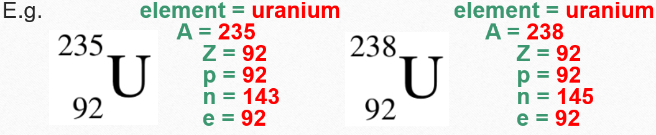
Answers
Isotopes are atoms with the same number of protons but different numbers of neutrons. This means that they are the same element but have different masses.

Slide 13
READ WITH ME
Electron arrangement
The arrangement of electrons in an atom is important because it determines the chemical properties.
Electrons are arranged in electron shells (energy levels). The lowest shells are filled first, with electrons with the least energy. Higher shells contain electrons with more energy.

Slide 14
READ WITH ME
Electron arrangement
Electron shell | Maximum number of electrons
1 | 2
2 | 8
3
4
5
Can you work out the rule for the maximum number of electrons allowed in each electron shell?

Slide 15
READ WITH ME
Electron arrangement
Can you work out the rule for the maximum number of electrons allowed in each electron shell?
2n²
Electron shell | Maximum number of electrons
1 | 2
2 | 8
3 | 18
4 | 32
5 | 50

Slide 16
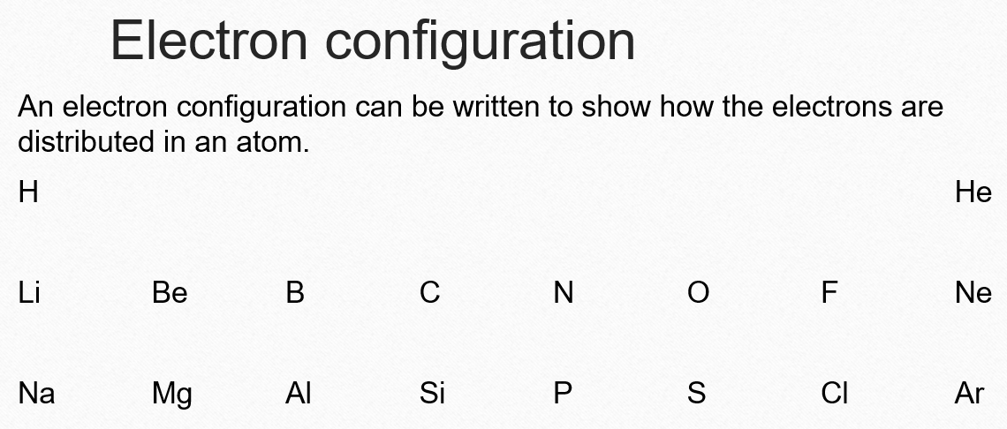

Slide 17
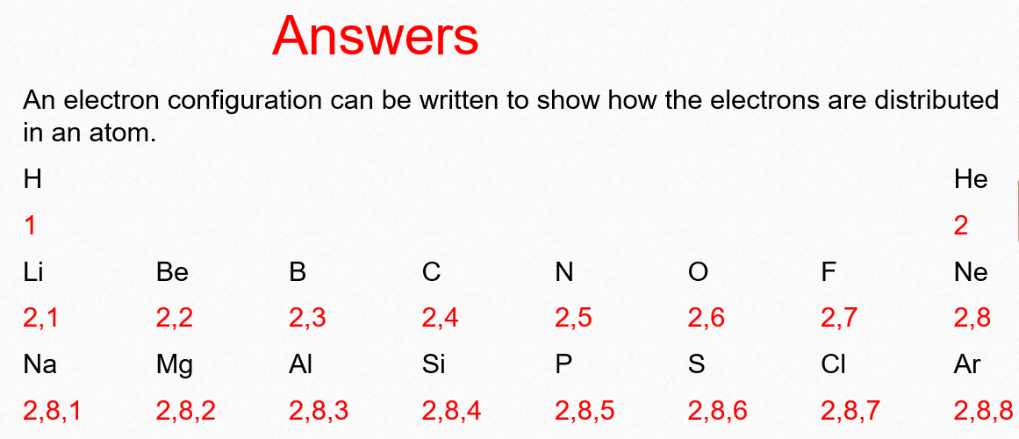

Slide 18
Atomic Structure Review
I can / will be able to:
Draw a labelled diagram of an atom
Describe the properties of subatomic particles (P, N, E)
Recall how to read an element from the Periodic Table
Explain the difference between an isotope and an element
Draw electron configurations of the first 20 elements

